Slide 1
Building and Rendering Planetary Bodies With Plate Tectonics
Justin Powell & Jon Denning
Taylor University
Dec 2015

Slide 2
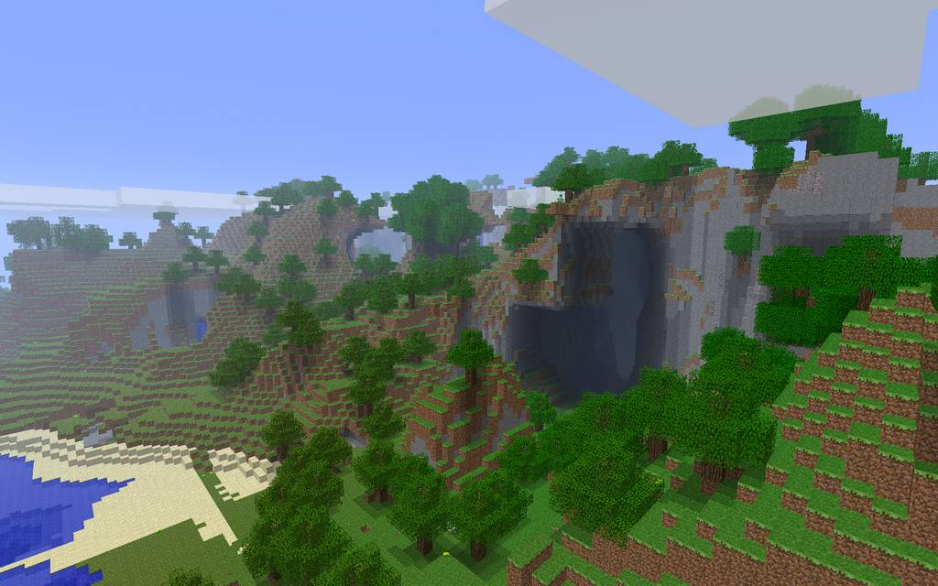
Planetary Rendering
Minecraft

Slide 3
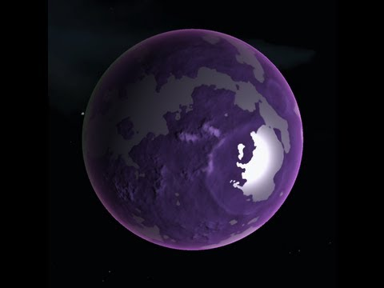
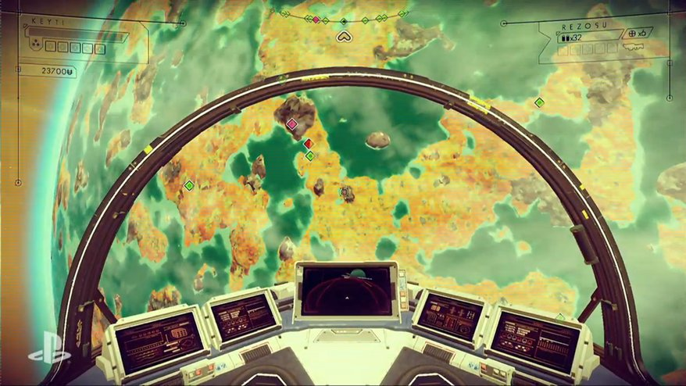
Planetary Rendering
Kerbal Space Program
No Man’s Sky

Slide 4
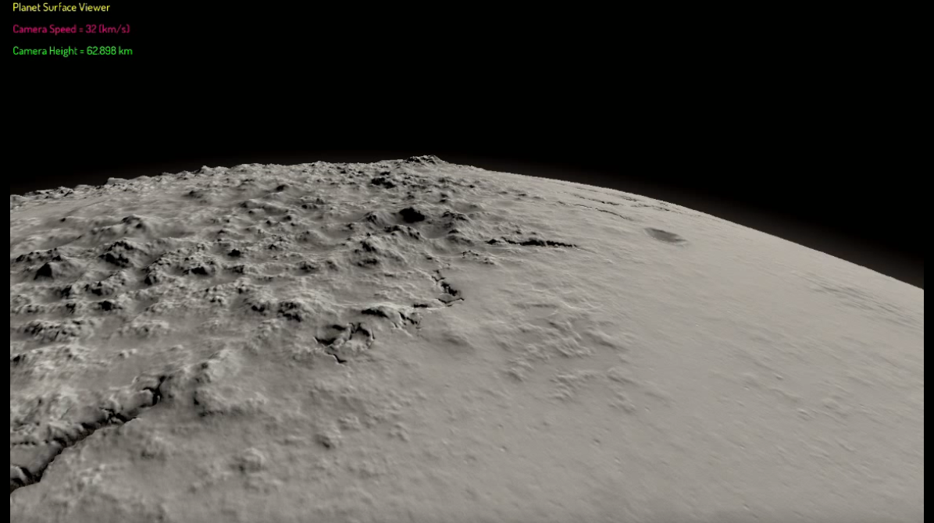
Planetary Rendering
Elite Dangerous

Slide 5
Project Goal
Generation and rendering of planetary bodies using plate tectonics to model terrain.
Must be generated at startup and render at interactive framerates.
Allow for multiple types of planetoids for use in a solar system simulation.

Slide 6
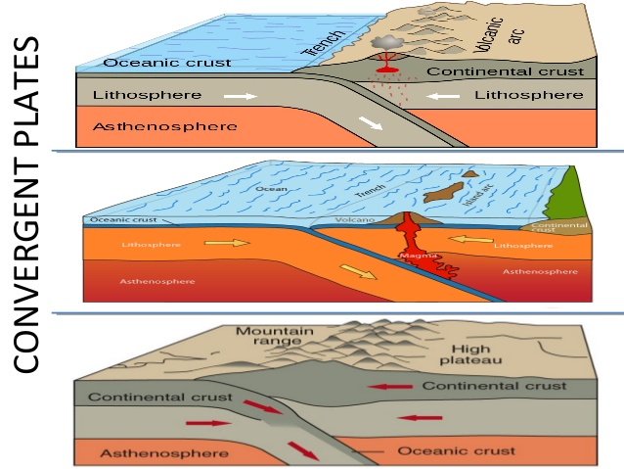
Plate Tectonic Theory
Convergent Boundary:
Occurs when two plates collide.
The denser plate subducts under the other.
Produces island chains, mountain
ranges, and volcanoes
depending on plate type.

Slide 7
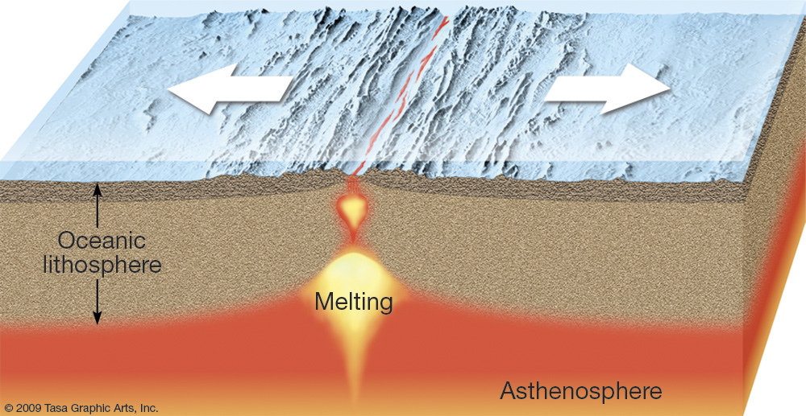
Plate Tectonic Theory
Divergent Boundary:
Occurs where two plates move in opposite directions.
Produces a rift where magma rises to the surface and produces new rock.

Slide 8
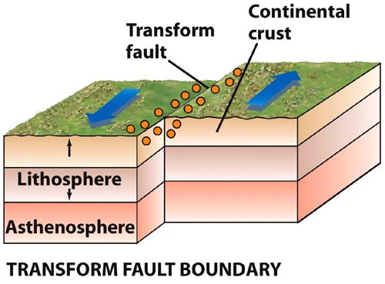
Plate Tectonic Theory
Transform Boundary:
Occur where plates move horizontally relative to each other.
No noticeable terrain features.

Slide 9
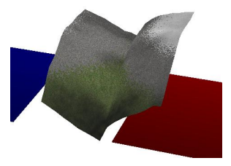
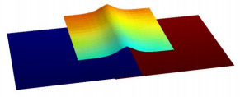
Previous works
Bendetti & Minto –
Two 2D rectangles represent the plates.
As they converge or diverge, a third plate called the “overlap plate” records the displacement which is applied to the base mesh.

Slide 10
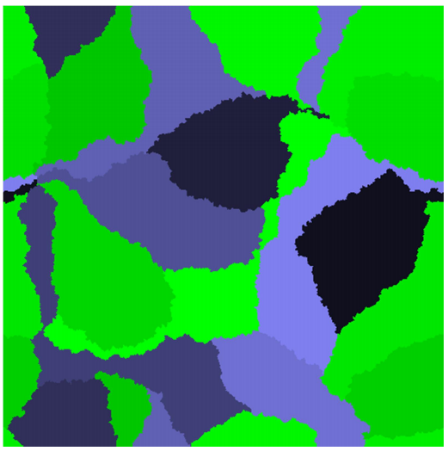
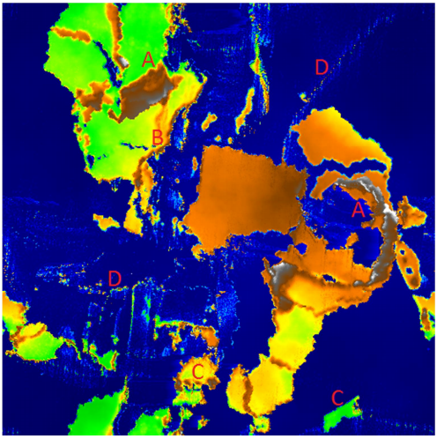
Previous Works
Viitanen –
A complex simulation which accounts for several factors such as plate mass, density, and velocity.
Accounts for erosion.
Simulation run on a 2D plain.

Slide 11
Considerations
Needs to generate all at startup.
Plate allocation
Terrain Generation
Needs to run at Interactive frame rates.
Detail needs to scale at distances.

Slide 12
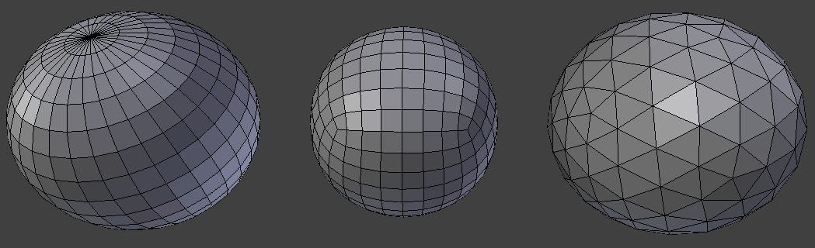
Implementation
Planet Mesh
Choice between UV sphere, quad sphere, and icosphere.
Two considerations:
Vertex distortion.
Adjacency Information
UV sphere quad sphere icosphere

Slide 13
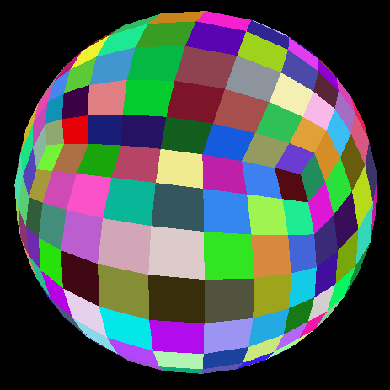
Implementation
Quad sphere
Less distortion than UV sphere.
Easier to traverse neighbors for tectonic plate assignment.
Easy to tessellate.

Slide 14
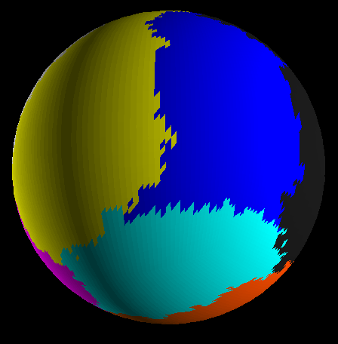
Implementation
Plate generation
Each plate starts with an initial face and grows out from there until each face is assigned to a plate.
Quick and simple to produce a varied number of plates.
Plate information is passed
to the graphics card to render
terrain.

Slide 15
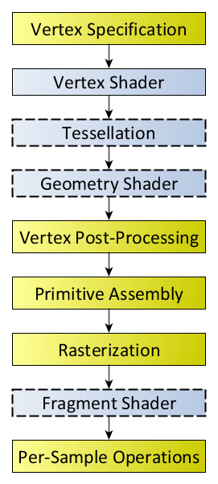
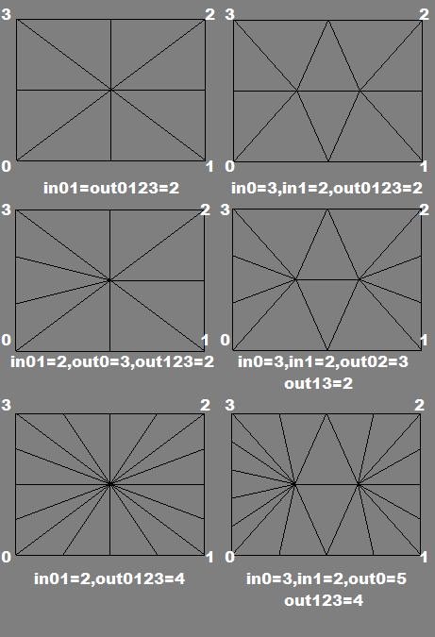
Implementation
Tessellation & Geometry shader
Optional part of the OpenGL rendering pipeline.
Facilitates the tessellation of input geometry and generation of new primitives.

Slide 16
Implementation
Tessellation
Base mesh is not tessellated enough for accurately rendering geometry.
Base mesh passed the graphics card in a format called “patches”.
Graphics card designed to quickly tessellate large numbers of geometry.

Slide 17
Implementation
Level of detail
Far away objects do not need to be as detailed as closer objects.
Improves performance to increase frames per second.

Slide 18
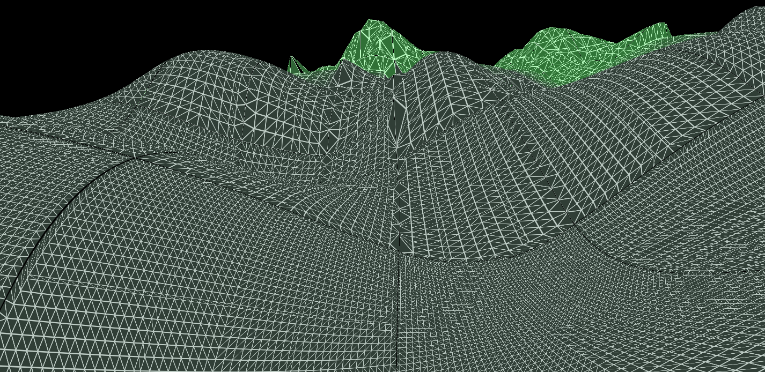

Slide 19
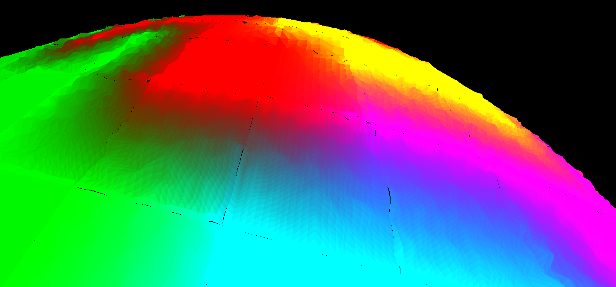
Implementation
Terrain visualization
Shader takes plate information and uses it to modify a perlin noise algorithm.
How the
shader views the plate information.

Slide 20
Implementation
Terrain contd.
Vertices within the boundary of two plates have rougher terrain to model mountains.
Within the center of plates the terrain is smoother.
All plate simulation is done on the shader.

Slide 21
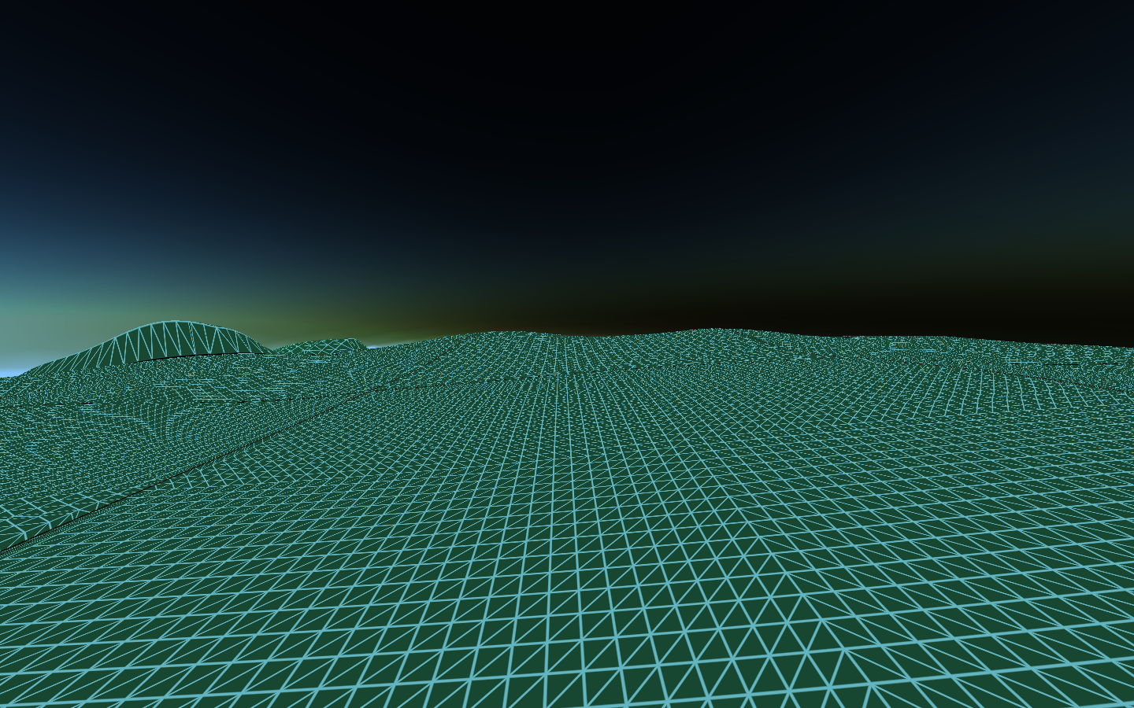
Results

Slide 22
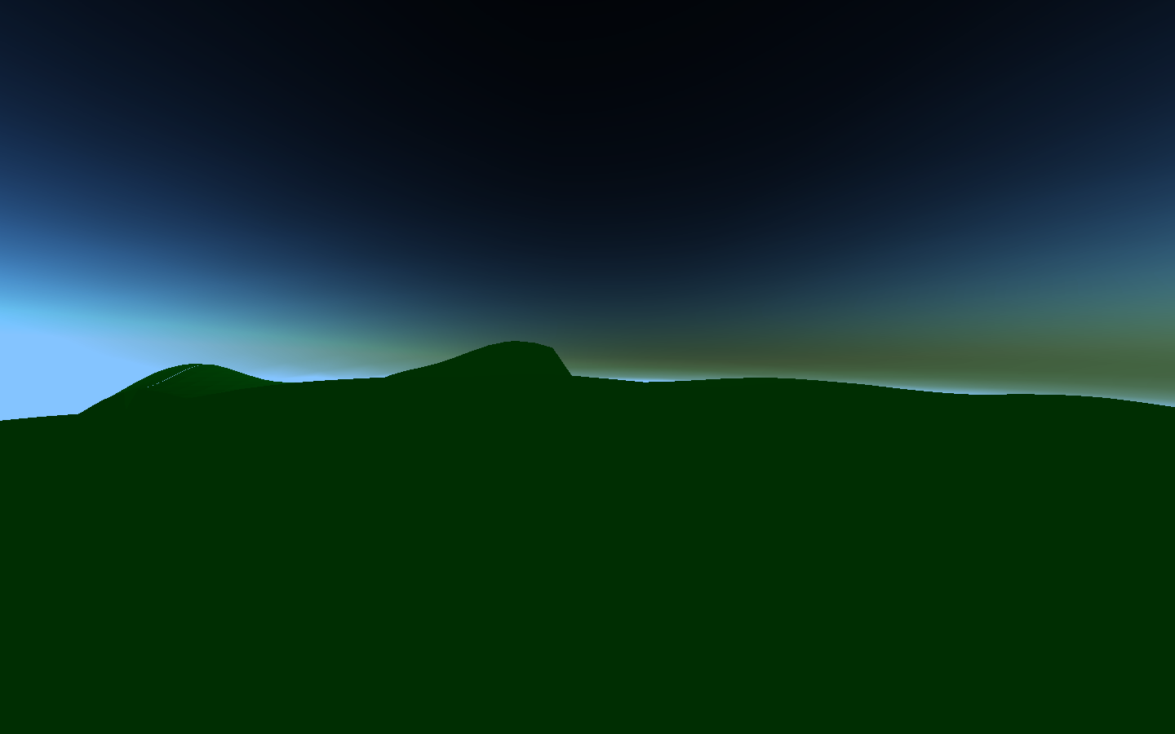

Slide 23
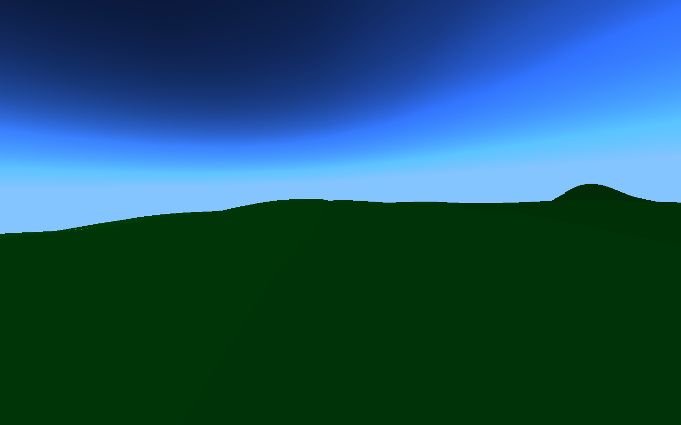

Slide 24
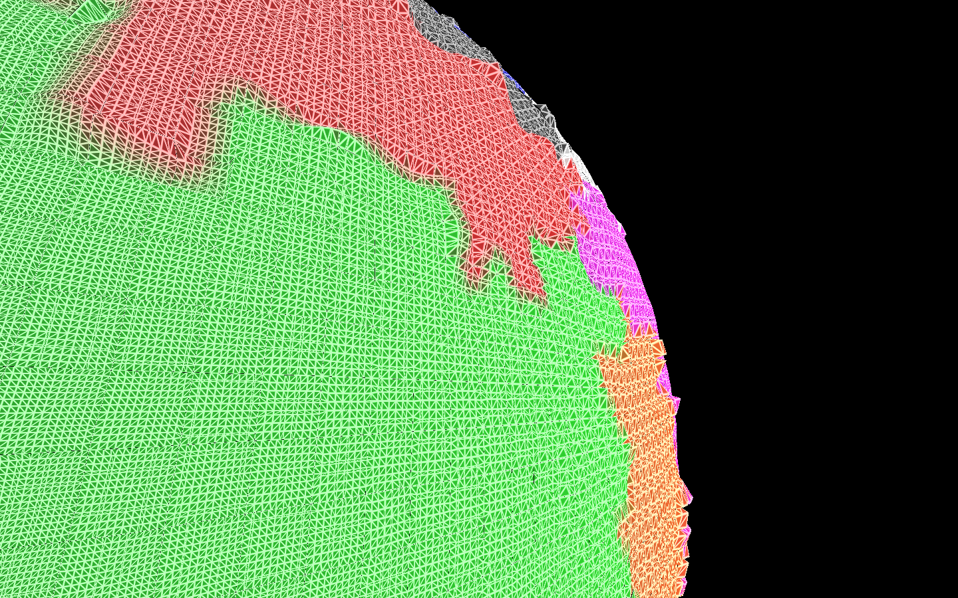

Slide 25
Limitations
Plate tectonic simulation very simple.
Does not model transform boundaries or hot spots.
Plate shapes jagged due to faces being quads.
All simulation is done on the shader. Requires careful tuning or extreme terrain occurs.
Level of detail algorithm does not work well with edges.
Causes tearing between patches.

